Slide 1
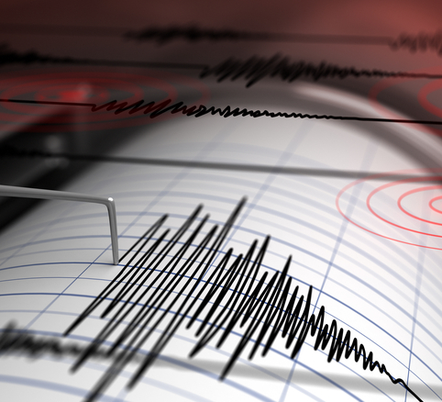
EARTHQUAKE INTEREVENT TIME DISTRIBUTIONS
... A First step towards earthquake forecasting

Slide 2
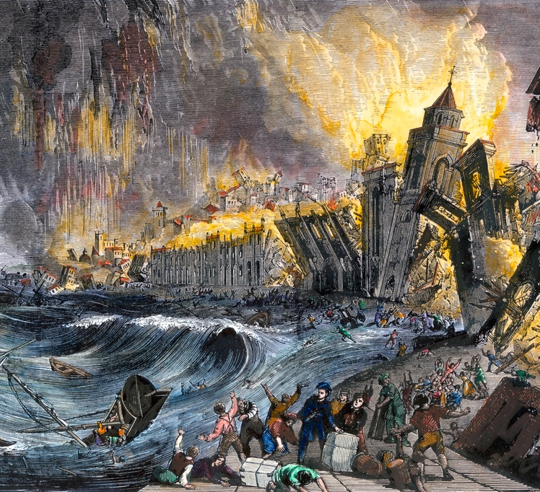
Why forecast earthquakes?

Slide 3
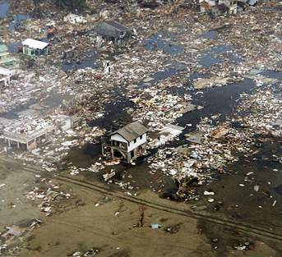
HERE'S WHY:
(In image: Sumatra, Indonesia after the deadly earthquake of 2004.
Credits : Getty Images)
- Because with prior warning, this damage could have been avoided, or at least minimized.
- While forecasting is not as precise as prediction, it helps us evaluate threats from a probabilistic viewpoint.

Slide 4
OUR APPROACH
A brief overview

Slide 5
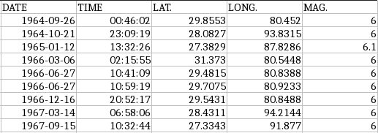
STEP 1: COLLECTING THE DATA
86 such events were found between 1900 and 2019.

Slide 6
STEP 2 : PREPROCESSING
Foreshocks and aftershocks were identified and removed.
A list of 73 I.I.D. events was obtained.
Interevent times were calculated.

Slide 7
STEP 3 : PARAMETER ESTIMATION
Using the fitdistr function in R, the following distributions were fitted to the data:
Exponential
Gamma
Weibull
Lognormal
Two methods were used for estimating parameters:
Maximum Likelihood Estimation
Method of Moments

Slide 8

RESULTS
Assumptions:
1. The earthquakes are independent of each other.
2. The mean occurrence rate remains constant

Slide 9
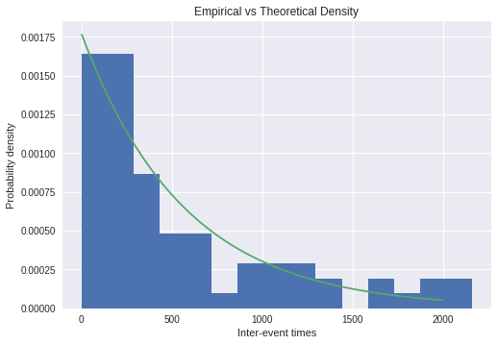
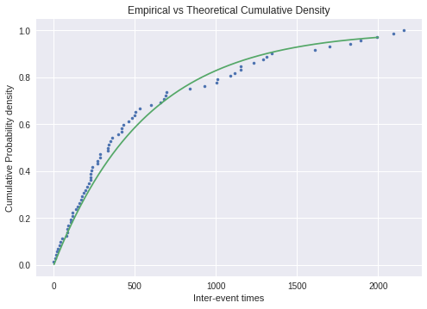
EXPONENTIAL DISTRIBUTION

Slide 10
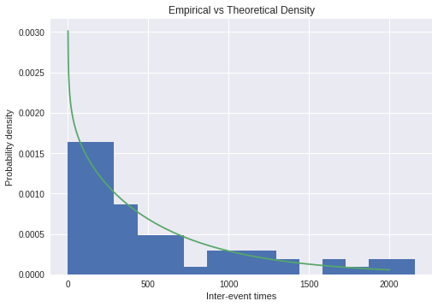
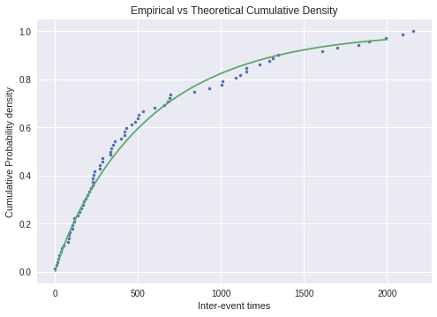
GAMMA DISTRIBUTION

Slide 11
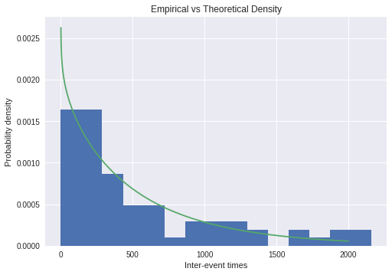

WEIBULL DISTRIBUTION

Slide 12

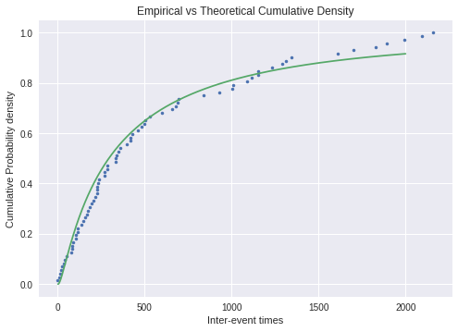
LOGNORMAL DISTRIBUTION

Slide 13
STEP 4 : MODEL EVALUATION
Two tests were applied:
The Kolmogorov-Smirnov (KS) Test, and
The Akaike Information Criterion (AIC) Test

Slide 14
EVALUATION RESULTS
 | AIC SCORE | KS TEST STATISTIC | KS P-VALUE
Exponential | 395.568 | 0.0749 | 0.7866
Gamma | 396.911 | 0.0628 | 0.9222
Weibull | 1060.141 | 0.0641 | 0.9102
Lognormal | 1074.17 | 0.084 | 0.6588

Slide 15
EVALUATION RESULTS
Interpretations :
KS test ranks the Gamma distribution highest
Exponential distribution wins out at the AIC test due to lesser number of parameters : AIC = -2(log-likelihood) + 2K,
K = number of parameters in the PDF expression

Slide 16
CONCLUSION: SO, HOW DO YOU FORECAST EARTHQUAKES?
SOLUTION : USE THE CUMULATIVE DISTRIBUTION FUNCTION!

Slide 17
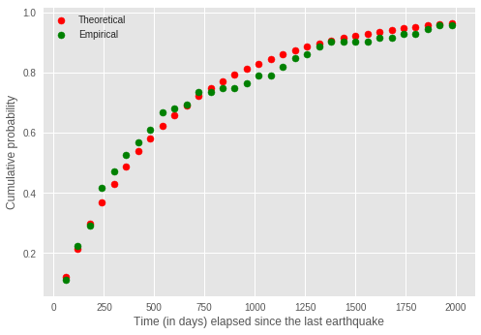
FOR INSTANCE,
It is now possible to comment on the odds that the next disaster will hit in the next 30, 60, 100, 200, 500, 1000 days.

Slide 18
LIMITATIONS
Forecasting is an easier task than prediction, which focuses on the exact time, location and magnitude of an incoming shock.
This analysis does not help us predict earthquakes, only forecast them.
Hence, stringent protective measures such as evacuation cannot be taken on the basis of this analysis.

Slide 19
THANK YOU!

